Slide 1
Car Price Prediction Project
Submitted By:
SYED MUGERA BILAL
syedbilalarmaan@gmail.com

Slide 2
Contents
About the project
Business Goal
Data source & their formats
Hardware, Software and Tools
Data Analysis
Data Cleaning
Exploratory Data Analysis (EDA)
Checking for outliers
Checking for skewness
Standardization / Scaling
Splitting the data
Building Machine Learning Algorithms
Evaluation of ML Models
Result of ML Models
Key Metrics for success in solving problem under consideration
Conclusion

Slide 3
About the project
Data Collection Phase
You have to scrape at least 5000 used cars data. You can scrape more data as well, it’s up to you. more the data better the model.
In this section You need to scrape the data of used cars from websites (Olx, cardekho, Cars24 etc.) You need web scraping for this. You have to fetch data for different locations. The number of columns for data doesn’t have limit, it’s up to you and your creativity. Generally, these columns are Brand, model, variant, manufacturing year, driven kilometers, fuel, number of owners, location and at last target variable Price of the car. This data is to give you a hint about important variables in used car model. You can make changes to it, you can add or you can remove some columns, it completely depends on the website from which you are fetching the data.
Try to include all types of cars in your data for example- SUV, Sedans, Coupe, minivan, Hatchback.

Slide 4
Model Building Phase
After collecting the data, you need to build a machine learning model. Before model building do all data pre-processing steps. Try different models with different hyper parameters and select the best model.
Follow the complete life cycle of data science. Include all the steps like.
1. Data Cleaning
2. Exploratory Data Analysis
3. Data Pre-processing
4. Model Building
5. Model Evaluation
6. Selecting the best model

Slide 5
Business Goal
With the covid 19 impact in the market, we have seen lot of changes in the car market. Now some cars are in demand hence making them costly and some are not in demand hence cheaper. One of our clients works with small traders, who sell used cars. With the change in market due to covid 19 impact, our client is facing problems with their previous car price valuation machine learning models. So, they are looking for new machine learning models from new data. We have to make car price valuation model.
Data source and their format
We collected the data from website www.cars24.com.The data is scrapped using Web scraping technique and the framework used is Selenium.
We scrapped nearly 10000 rows of the data and saved as csv file.

Slide 6
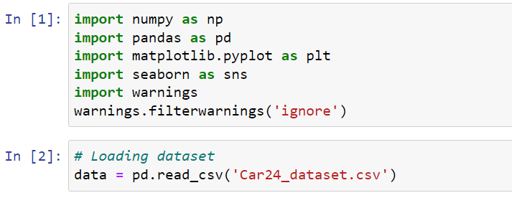
Hardware, Software and Tools
For doing this project, we require laptop with high configuration and specification with a stable Internet connection.
Microsoft office, Anaconda distribution as software.
Python 3.x as programming language.
Jupyter Notebook as Editor which is in Anaconda navigator.
Some tools or libraries required like Numpy – used to numerical calculations. Pandas – used to data manipulation. Matplotlib and Seaborn – used to data visualization.

Slide 7
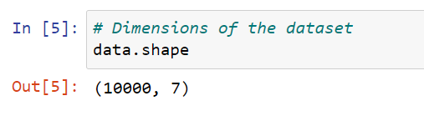
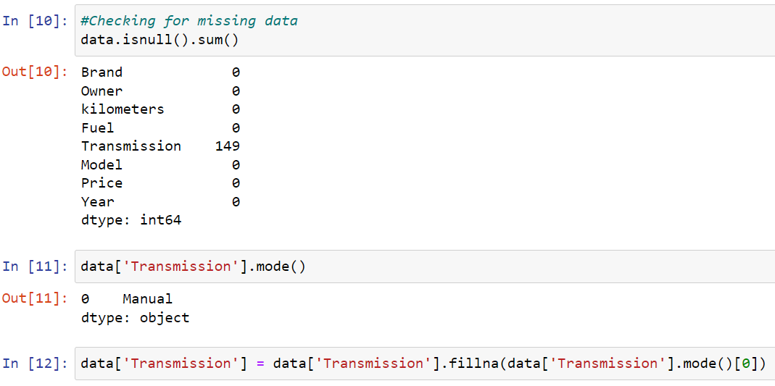
Data Analysis
The dataset has 10000 rows and 7 columns.
We have seen that, in Transmission column there are 149 missing values are available. We have find mode of Transmission column and filled with mode value. (i.e. Manual)

Slide 8
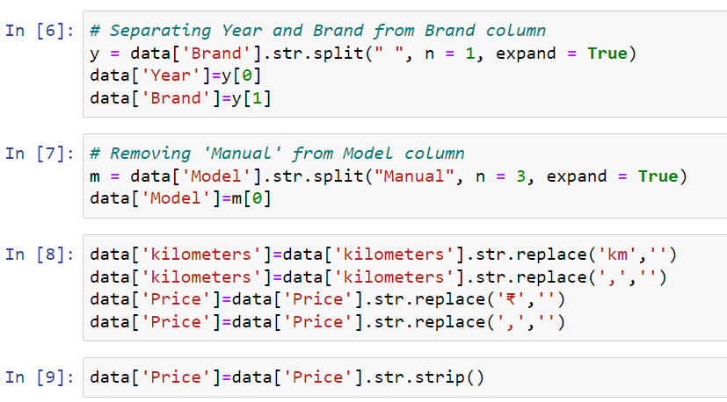
Data Cleaning
Removing words from object data and converting them into int data type.
Removing ‘,’ , ‘ ’ replacing missing data with highest weightage data.
Removing unnecessary features.

Slide 9
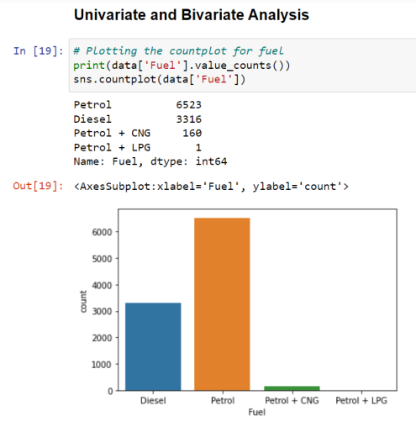
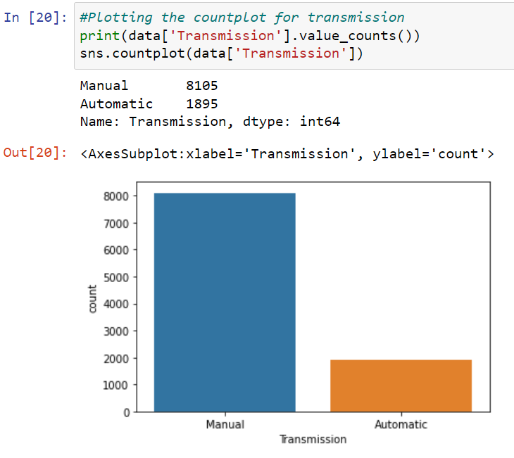
Exploratory Data Analysis (EDA)
Observations:
We can see that Petrol is the maximum fuels used by cars, whereas Diesel, CNG and LPG are the least used.
Observations:
Most of the cars have manual transmission as the highest weightage.

Slide 10
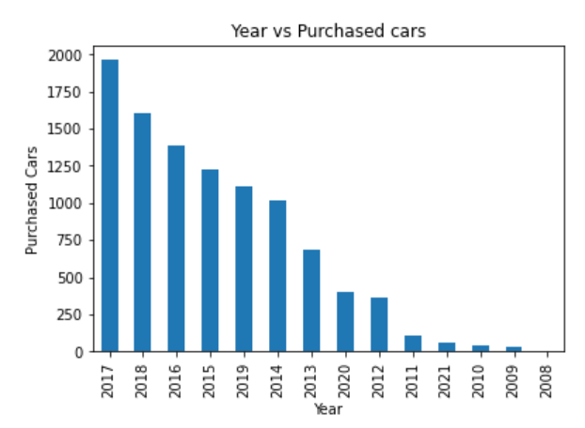
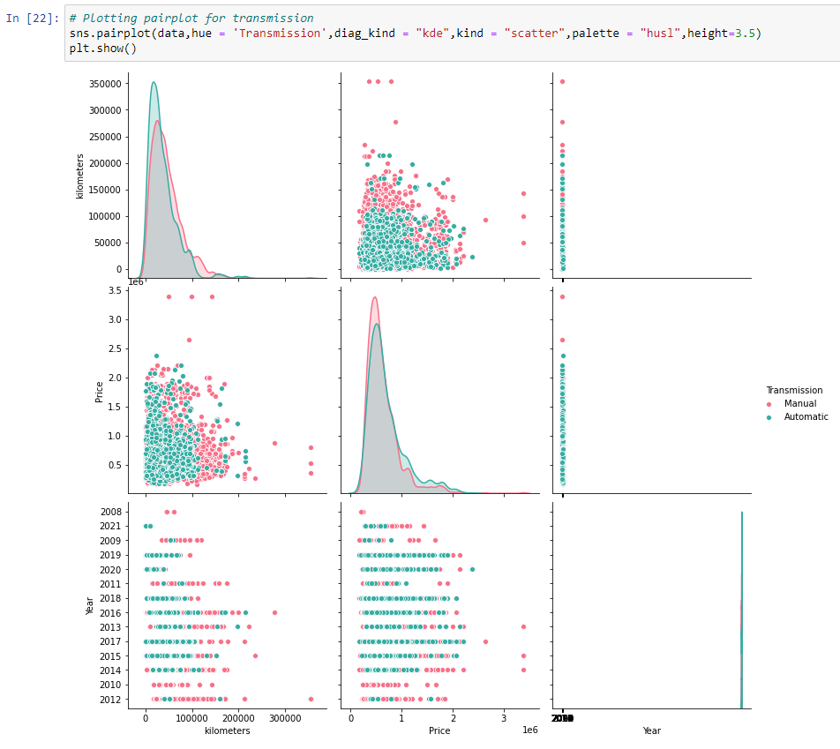
Observations:
Maximum number of cars are bought in the year 2017 whereas minimum number of cars were brought in 2009 and 2008.

Slide 11
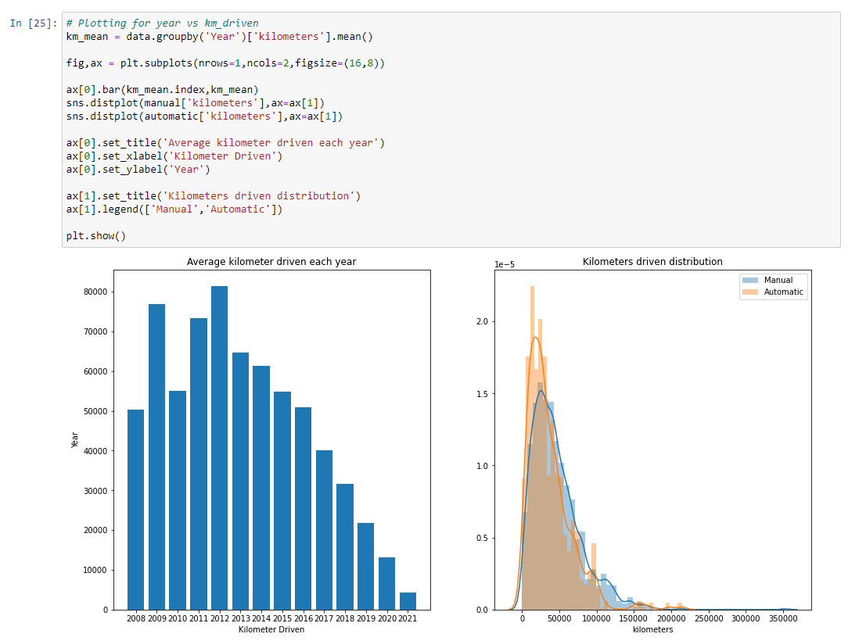

Slide 12
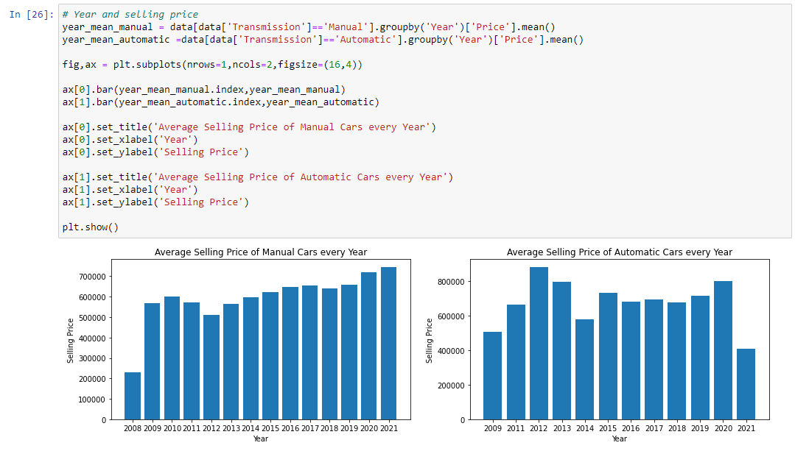

Slide 13
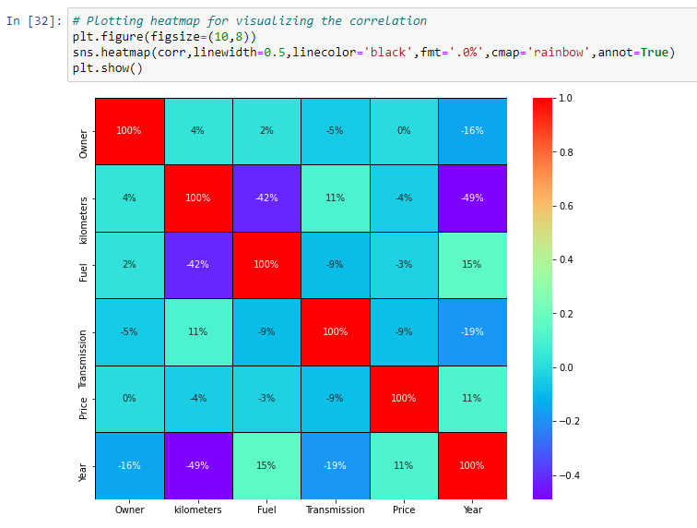
Multivariate Analysis
Observations:
1. There are more negative correlations present in the dataset
2. Highest positive correlated column has a value of 15%.
3. Highest negatively correlated column has a value of -49%
4. Positively correlated columns have a high impact with the target variable whereas negatively correlated columns have less or zero impact with the target variable.

Slide 14
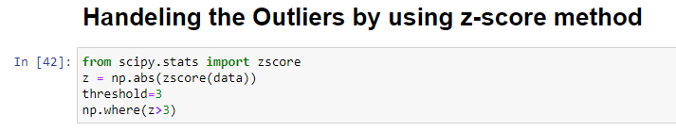
Checking for outliers
Outliers are the data points that differ significantly from other observations. Any data points greater than +3 and -3 standard deviations are called as outliers.
Z-score is the automated method used for handling outliers and it’s important to remove outliers as it impacts on the Accuracy of the Model.
During the outlier’s analysis, we found that we are losing nearly 6% of data and it’s not a big loss.
After removing outliers, we have 9405 rows and 6 columns.

Slide 15
Checking for skewness
Skewed data are not normally distributed; either they are positive skewed or negative skewed. If the data is skewed, it impacts on the accuracy of the model. So, it’s very important to remove the skewness for right and left skewed data by using transform methods like square root transformation.
For visualization, we use distplot to check the distribution of data points and the shape of the curve. Any value greater than 0.55 or less than -0.55 is considered to be skewed data.
In our case, most of the data are skewed and hence we have to remove the skewness during Scaling because if we remove the skewness by square root transformation method it will induce nan values. Sometimes while using root transforms, it can cause to form nan values. It is better to remove those values before scaling because it will show ValueError while running the code.

Slide 16
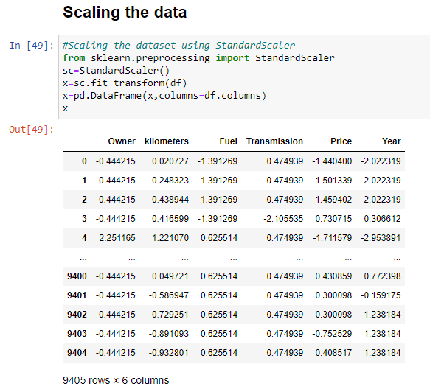
Standardization / Scaling
Standardization of data is done by using Standard Scaler.
Standard scaler is used to bring the data points to standard Normal Distribution having mean = 0 and SD +- 1 to enhance accuracy of the model. In our case, its most important due to presence of high skewed data and Outliers.

Slide 17
Splitting the data
We split our dataset into two parts training and testing, with 80% data of training and 20% of testing. We use train test split method.
80% of the observation as training set. x_train
The associated target for each observation in x_train , y_train
20% of the observation as test. x_test
The target associated with the test set. y_test
We found best score on random_state = 51

Slide 18
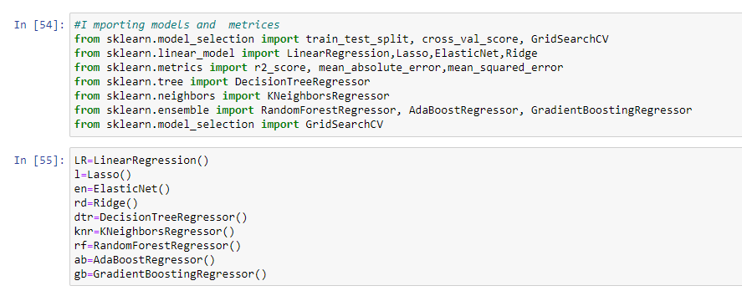
Building Machine Learning Algorithms
The following classifier algorithms we used are:
Linear Regression, Lasso, Ridge, ElasticNet
Decision Tree Regressor
KNeighbors Regressor
Random Forest Regressor, AdaBoost Regressor, Gradient Boosting Regressor

Slide 19
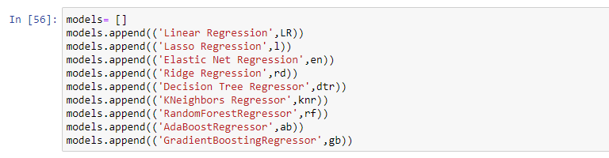
Evaluation of ML Models
As you can see , I had called the algorithms, then I called the empty list with the name models [ ], and calling all the model one by one and storing the result in that.
We can observe that I imported the metrics to find the r2_score, mean_absolute_error (MAE) ,mean_squared_error (MSE), root_mean_squared_error (RMSE) in order to interpret the model’s output. Then I also selected the model to find the cross_validation_score value.

Slide 20
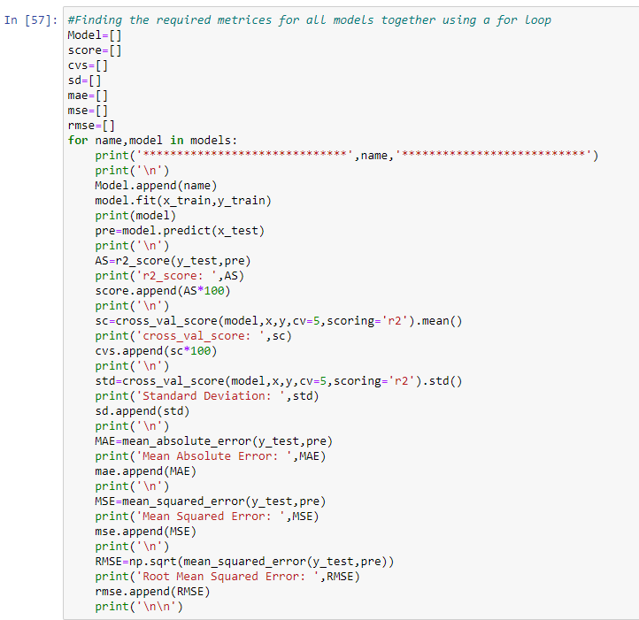
As you can observe, I made a for loop and called all the algorithms one by one and appending their result to models.
Let me show the output so that we can glance the result in more appropriate way.

Slide 21
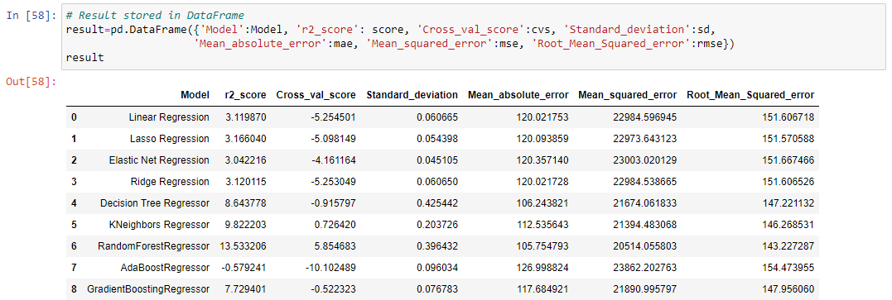
Result of ML Models
We saved result of ML Models in DataFrame.
We can see that Random Forest Regressor and KNeighbors Regressor are performing well compared to other algorithms. Now we will try Hyperparameter Tuning to find out the best parameters and try to increase the scores.

Slide 22
Key Metrics for success in solving problem under consideration
r2_score
Mean Absolute Error (MAE)
Mean Square Error (MSE)
Root Mean Square Error (RMSE)
Cross-validation
Hyperparameter Tuning using GridSearchCV
After hyperparameter tunning the accuracy score of Random Forest Regressor is increased, 13.53 to 16.84 and Cross validation score is 5.85 to 8.96.

Slide 23
Conclusion
After web scraping from cars24.com (using selenium) we making a dataset in csv format.
First, we loaded the dataset and did the EDA process and other pre-processing techniques like skewness check and removal, handling the outliers present, filling the missing data, visualizing the distribution of data, etc.
During the outlier’s analysis, we found that we are losing nearly 6% of data and it’s not a big loss.
Then we did the model training, building the model and finding out the best model on the basis of different metrics scores we got like r2_score, Mean Absolute Error (MAE), Mean Square Error (MSE), Root Mean Square Error (RMSE), Cross-validation

Slide 24
We used algorithms like Linear Regression, Lasso Regression, Ridge Regression, ElasticNet, Decision Tree Regressor, KNeighbors Regressor, Random Forest Regressor, AdaBoost Regressor, Gradient Boosting Regressor
After performing the analysis, we got KNeighbors Regressor and Random Forest Regressor algorithm as the best algorithms among all. After that finding out the best parameter and improving the scores, we performed Hyperparameter Tuning.
The problem while doing Hyperparameter Tuning is that it took nearly 2 hours to fetch the best parameters.
After Tuning Random Forest Regressor is selected as the final model at R2 Score of 16.84 with Hyper-parameter tuning.
We finalized the best model we obtained by saving the model in an pkl file.

Slide 25


